Slide 1
Predicting Maternal Health Risk After Delivery
By
Roshan Pampari
PreethaM Thatikonda
Sarvagna KoTTE
Yogendra Kodali
Pavan Kumar Etta

Slide 2
Motivation and Objective
Motivation:
Maternal health is crucial for reducing post-delivery complications.
Early risk prediction can guide timely medical interventions, improving outcomes.
Objective:
Predict the risk level (high, mid, low) of women after delivery using health indicators.
Develop a reliable model to assist healthcare providers in prioritizing care.
How:
Applied data mining techniques on a clinical dataset with various physiological features.
Focused on interpretable models to ensure clinical applicability.

Slide 3
About the Dataset
Source: Public dataset on maternal health risk (e.g., UCI Machine Learning Repository)
Attributes:
  Age
  Systolic & Diastolic Blood Pressure
  Blood Sugar (BS)
  Body Temperature
  Heart Rate
  RiskLevel (Target: High, Mid, Low
Instances: 1014 Rows
No missing values: Ensured data integrity for robust analysis.

Slide 4
Preprocessing Insights
Data Cleaning:
No null values found.
Verified feature ranges for clinical relevance (e.g., Blood Pressure within 90–180 mmHg, Heart Rate 60–100 bpm).
Exploratory Analysis:
Visualized all features using bar plots and correlation heatmaps to identify relationships.
Key observation: Based on correlation matrix, systolicBP and diastolicbp have high correlation.
Conversion:
RiskLevel converted to a factor with 3 classes for classification.
Normalized numerical features to ensure model compatibility.

Slide 5
Proposed Techniques
Model Selection Rationale:
Random Forest: Handles overfitting better than single trees, good for tabular data, robust to noise.
Logistic Regression: Baseline model for classification, interpretable coefficients, handles multiclass via one-vs-rest.
Evaluation Metrics:
Accuracy: Overall model performance.
Confusion Matrix: Assesses performance across high, mid, low risk classes.
ROC Curve: One-vs-all for multiclass to evaluate model discrimination.
Cross-Validation:
Used 5-fold cross-validation to ensure robust model evaluation.

Slide 6
Model Results
Models Tried: Random Forest and Logistic regression
Best Performing Model: Random Forest
Accuracy:
Model | 80/20 Split | 50/50 Split
Random Forest | 84.65 % | 80.27 %
Logistic Regression | 62.87 % | 63.7 %

Slide 7
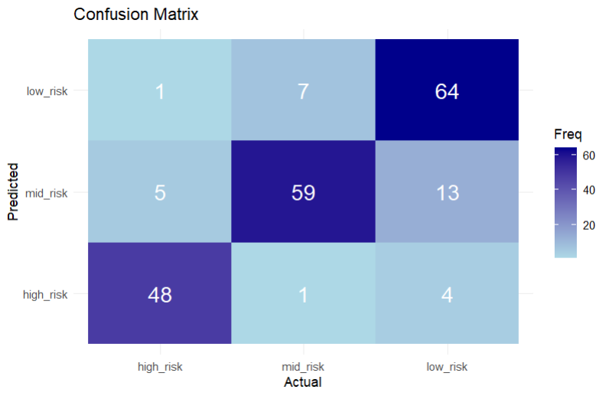
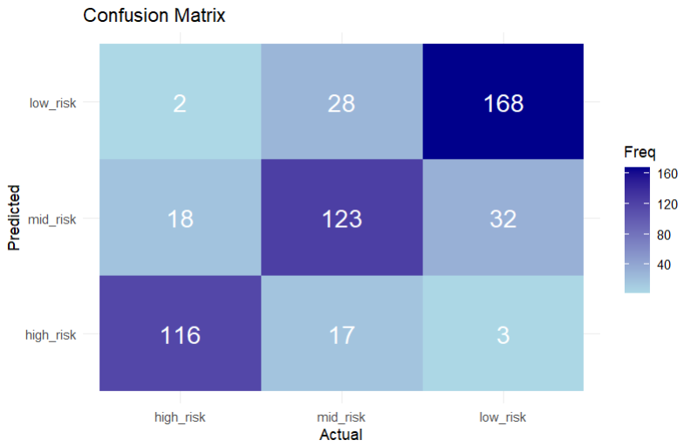


Random Forest Results
Confusion Matrix:
80/20 Split 50/50 Split

Slide 8
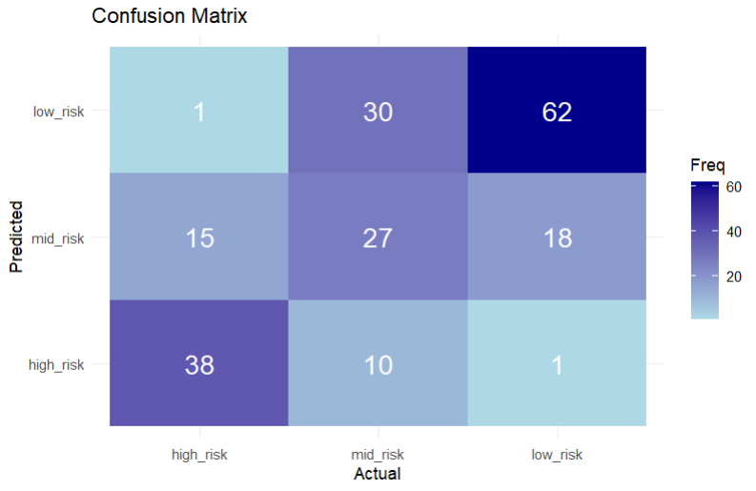



Logistic regression Results
Confusion Matrix:
80/20 Split 50/50 Split

Slide 9
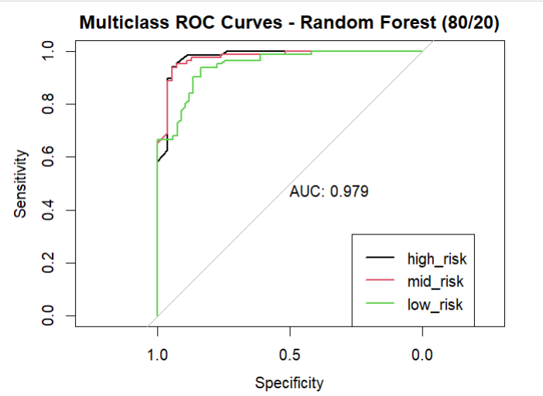
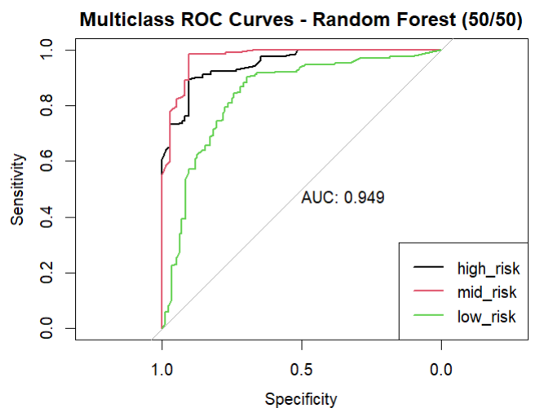
Random forest roc

Slide 10
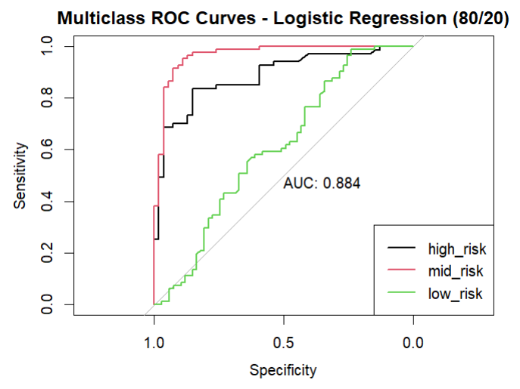
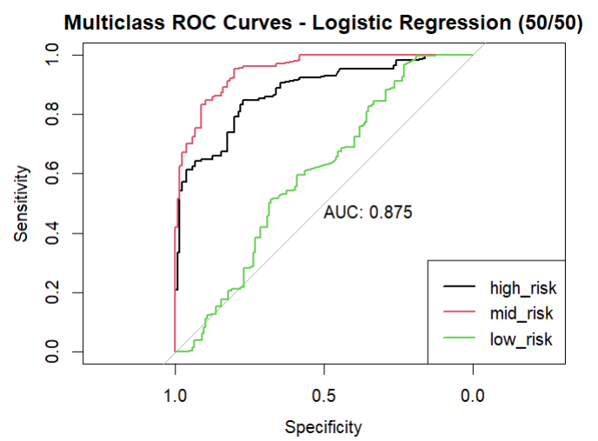
LOGISTIC REGRESSION roc

Slide 11
Practical Implications
Real-World Application:
Model can assist doctors in prioritizing high-risk patients for monitoring or intervention.
Interpretable decision tree rules can be integrated into clinical decision support systems.
Ethical Considerations:
Ensure model fairness across age groups to avoid biased predictions.
Address imbalanced data to prevent underpredicting high-risk cases.
Future Deployment:
Integrate with electronic health records for real-time risk assessment.
Validate model on diverse populations to enhance generalizability.

Slide 12
Conclusion & Discussion
Summary:
  Built and evaluated a decision tree to classify maternal risk.
  Clean dataset with interpretable features.
Findings:
  Certain features like BP and Heart Rate significantly affect prediction.
Limitations:
  Dataset size may limit generalizability.
  Imbalanced classes may affect performance.
Proud Moment: Successfully implemented a medical application using data mining.

Slide 13
refefrences
https://www.liebertpub.com/doi/abs/10.1089/jwh.2015.5260
https://www.cdc.gov/mmWr/preview/mmwrhtml/ss5304a1.htm
https://pmc.ncbi.nlm.nih.gov/articles/PMC11988796/

